Slide 1
Title: Understanding Myers’ Diff Algorithm
Subtitle: Explanation, Pseudocode, and Optimizations Presented by: Sahil Madaan Based on: Blog by James Coglan — The Myers Diff Algorithm (Part 1–3)

Slide 2
Introduction
What is a Diff Algorithm?
Compares two sequences (like files or strings).
Outputs the minimal changes to transform one sequence into another.
Useful in version control (e.g., Git), text comparison, etc.

Slide 3
Myers’ Algorithm – Overview
What is Myers’ Diff Algorithm?
Developed by Eugene W. Myers (1986).
Computes the shortest edit script (SES) between two sequences.
Time Complexity: O(N × D)
Space Complexity: O(N + D)
where
N is length of input
D is number of differences,

Slide 4
Key Concepts in Myers' Algorithm
Core Concepts
Works on an edit graph: a 2D grid of possible edits.
Three operations:
Match (diagonal move)
Insert (downward move)
Delete (rightward move)
Finds the shortest path from (0,0) to (n,m).

Slide 5
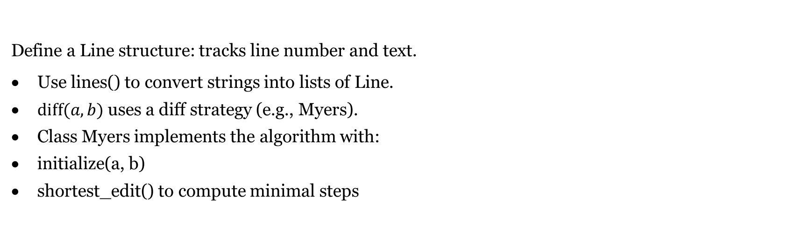
Basic Implementation Outline
Define a Line structure: tracks line number and text.
Use lines() to convert strings into lists of Line.
$diff(a,b)$ uses a diff strategy (e.g., Myers).
Class Myers implements the algorithm with:
initialize(a, b)
shortest_edit() to compute minimal steps

Slide 6
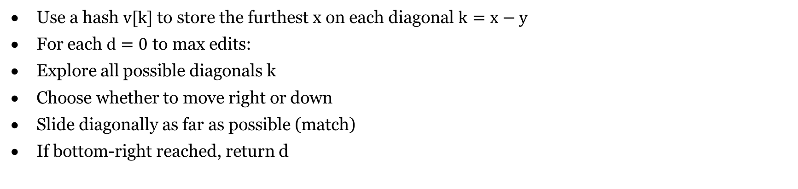
Step-by-Step Logic
Use a hash $v[k]$ to store the furthest x on each diagonal $k=x−y$
For each $d=0$ to max edits:
Explore all possible diagonals k
Choose whether to move right or down
Slide diagonally as far as possible (match)
If bottom-right reached, return d

Slide 7
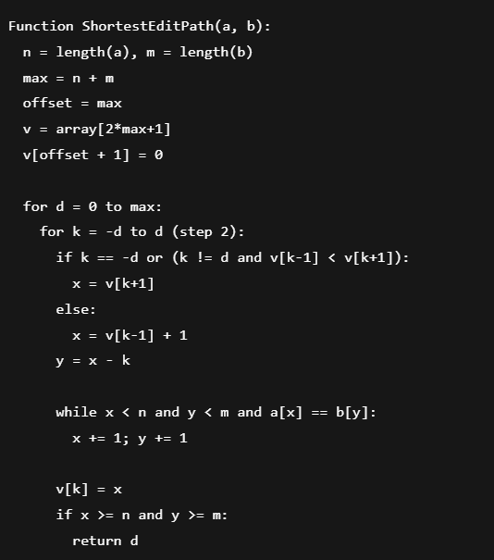
Myers' Algorithm – Pseudocode

Slide 8
What's Missing in Basic Implementation
Returns only number of edits, not edit operations
No tracking of insert/delete/match sequence
Space usage can be high for large inputs if tracking all paths
No optimization for common prefixes/suffixes

Slide 9
Optimizing Myers with Hirschberg’s Algorithm
A divide-and-conquer approach to LCS
Reduces space from O(N×M) to O(N)
Splits problem at midpoint
Recursively solves smaller subproblems
Useful when working with large files

Slide 10
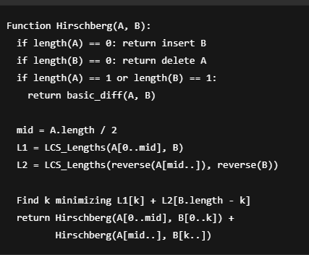
Hirschberg’s Algorithm – Pseudocode

Slide 11
Ways to Improve the Algorithm
Add full backtracking to return edits (insert, delete, match) Trim matching prefixes and suffixes for speed Use Hirschberg for large sequences Implement visual diff formatting Cache edit distances for repeated subproblems (memoization)

Slide 12
Where is Myers Used?
Git diff engine
Visual diff tools (Meld, Beyond Compare)
Merging tools
Code review systems

Slide 13
Recap
Myers’ Algorithm: efficient and elegant solution for diffing
Uses edit graphs and diagonals to minimize edits
Hirschberg optimizes space for large inputs
Practical and foundational for real-world version control

